Slide 1
Building corporate culture
Creating a Positive and Productive Work Environment

Slide 2

Building Corporate Culture
Name : Dhirajlal Sonagara
Department : UI/UX Designer
Date : 18/6/25

Slide 3
What is Corporate Culture?
Corporate culture define the company’s identity. Corporate culture is just not only about work in the company. It is also about how company employees interact with each other & outside with the clients. Corporate culture is about moral, work environment & company’s reputation. It also about how it helps to grow up employees make sure they works with interest & focus.

Slide 4
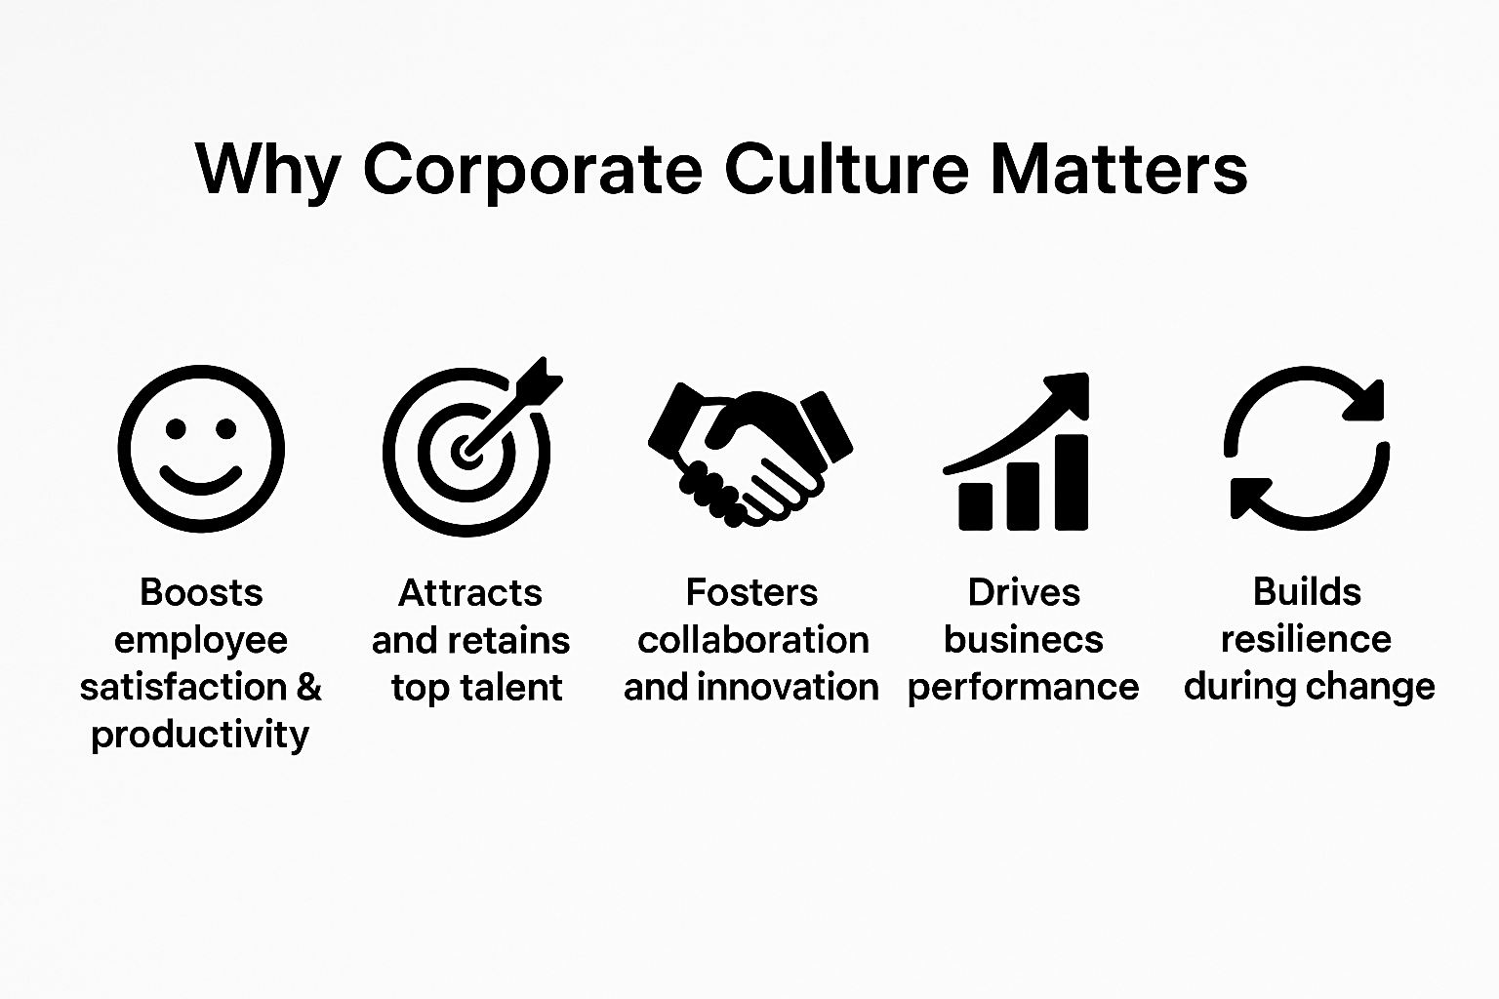
Why is Corporate Culture Important?

Slide 5
Elements of Corporate Culture
Vision: Defines the business objectives and what the company strives to achieve.
Values: Guide the behavior and approach the company takes to realize its vision.
Practices: Reflect the vision and values of the company.
People: A company’s culture exits largely because of the people it employes.
Credibility: Employees at great workplace find their people managers and leaders to be more credible.
Respect
Fairness
Pride
Belonging
Effective leadership
Innovation

Slide 6
How to Build a Strong Corporate Culture
Decide what your ideal company culture looks like
Compare ideal company culture to the existing one
Ask employees for input
Encourage work-life balance to reduce stress
Make sure Employees know your expectations
Hire candidates for culture first
Use digital tools and digital workplace to connect with employees
Recognize employee achievements
Remind employees that their work matters
Create opportunities for employees to build relationship

Slide 7
Real life example of corporate culture
Google culture is Open, innovative & fun because it focuses on employee autonomy, open communication. Environment where employees feel comfortable to share their ideas and contribute to company’s innovative spirit.
Infosys prioritize ethical practices, structured learning, and a learning-driven approach, particularly in the context of AI adoption.

Slide 8
Challenges in Building Corporate Culture
Multiculture/global teams
Communication barriers
Cultural sensitivities
Time management and work styles
Resistance to change:
Fear of unknown
Lack of understanding
Discomfort with disruption
Misalignment between leadership & employees:
Different values and priorities
Lack of trust
Poor communication

Slide 9
How to Maintain a Healthy Culture
If your company have a healthy corporate how to maintain it?
To maintain healthy culture focus on open communication, promoting employee well-being, and encouraging collaboration.
This includes form a clear values, providing opportunities for growth, and recognizing achievements.

Slide 10
Conclusion
Corporate culture is what gives life to a workplace. It’s more than just rules or processes—it's about how people feel when they show up to work every day. A positive culture encourages openness, respect, and creativity. It helps people feel connected to their work and to each other. When leaders genuinely support their teams, celebrate their successes, and create space for growth, it reflects across the entire organization. And maintaining that kind of culture isn’t a one-time effort—it’s something you nurture continuously by listening, supporting, and evolving together.

Slide 11
Thank You !
Presented by:
Dhirajlal Sonagara
UI/UX Designer
Email: sonagaradhiraj574@gmail.com
Phone: 9327733886

